Slide 1

Credit Card Fraud
Govind Soni

Slide 2
Agenda
Objective
Background
Key Insights
Cost Benefit Analysis
Appendix:
Data Attributes
Data Methodology
Attached Files

Slide 3
Definition
Credit card fraud is any dishonest act or behaviour to obtain information without the proper authorisation of the account holder for financial gain. Among the different ways of committing fraud, skimming is the most common one. Skimming is a method used for duplicating information located on the magnetic stripe of the card. Apart from this, other ways of making fraudulent transactions are as follows:
Manipulation or alteration of genuine cards
Creation of counterfeit cards
Stolen or lost credit cards
Fraudulent telemarketing

Slide 4
Objective
Getting in place a credit card fraud detection system to save on incurred costs incurred Huge costs are being incurred due to frauds and a manual detection system

Slide 5
Background

A machine learning model has been built to detect frauds early and mitigate losses A cost benefit analysis has been done for the deployment of the same

Slide 6
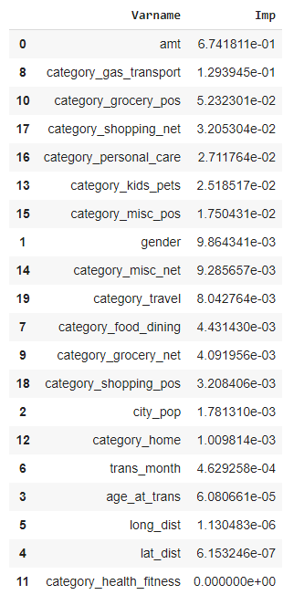
Key Insights
Transaction amount, category and gender are the most important variables Gas and transport, grocery and shopping are the top three categories

Slide 7
Current Incurred Losses
 
77,183 credit card transactions per month 402 fraudulent transactions per month $ 530.66 amount per fraud transaction Total costs incurred from fraud transactions is $213,392.22

Slide 8
After New Model Development
1720 fraudulent transactions detected by the model $ 1.5 cost to provide customer support to these transactions that is $ 2,580.38 in total 68 fraudulent transactions not detected by model which amounts to $ 35,908.09 loss Total cost incurred after new model deployment is $ 38,488.46 Final savings after new model deployment is $174,903.76 that is reduction in losses by ~82%

Slide 9
 | Cost Benefit Analysis
 | S. No | Questions | Answer
 | a | Average number of transactions per month | 77,183
 | b | Average number of fraudulent transaction per month | 402
 | c | Average amount per fraud transaction | 530.66
Cost Benefit Analysis
S. No | Questions | Answer
1 | Cost incurred per month before the model was deployed (b*c) | 213,392.22
2 | Average number of transactions per month detected as fraudulent by the model (TF) | 1,720
3 | Cost of providing customer executive support per fraudulent transaction detected by the model | 1.5
4 | Total cost of providing customer support per month for fraudulent transactions detected by the model (TF*$1.5) | 2,580.38
5 | Average number of transactions per month that are fraudulent but not detected by the model (FN) | 68
6 | Cost incurred due to fraudulent transactions left undetected by the model (FN*c) | 35,908.09
7 | Cost incurred per month after the model is built and deployed (4+6) | 38,488.46
8 | Final savings = Cost incurred before - Cost incurred after(1-7) | 174,903.76

Slide 10
Appendix: Data Attributes
o o o o o o o merch_long - o Fraud Flag <---
Snapshot of the data: index - Unique Identifier for each row transdatetrans_time - Transaction DateTime cc_num - Credit Card Number of Customer merchant - Merchant Name category - Category of Merchant amt - Amount of Transaction first - First Name of Credit Card Holder last - Last Name of Credit Card Holder gender - Gender of Credit Card Holder street - Street Address of Credit Card Holder city - City of Credit Card Holder state - State of Credit Card Holder zip - Zip of Credit Card Holder lat - Latitude Location of Credit Card Holder long - Longitude Location of Credit Card Holder city_pop - Credit Card Holder's City Population job - Job of Credit Card Holder dob - Date of Birth of Credit Card Holder trans_num - Transaction Number unix_time - UNIX Time of transaction merch_lat - Latitude Location of Merchant Longitude Location of Merchant is_fraud - Target Class

Slide 11
Appendix: Data Methodology
A random forest classifier built on top a Kaggle simulated dataset Class imbalance adjusted using Adaptive Synthetic (ADASYN) sampling method Manual hyperparameter tuning done due to extensive computational times when using Grid Search Cross Validation

Slide 12
Attached Files
A pdf file for the root cause analysis, Two excel workbooks for the 5ws+how problem-solving framework and the cost-benefit analysis, A jupyter notebook for the fraud detection model, (This) a powerpoint presentation for data storytelling and A video explaining the results and business impact.

Slide 13
Thanks

